Slide 1
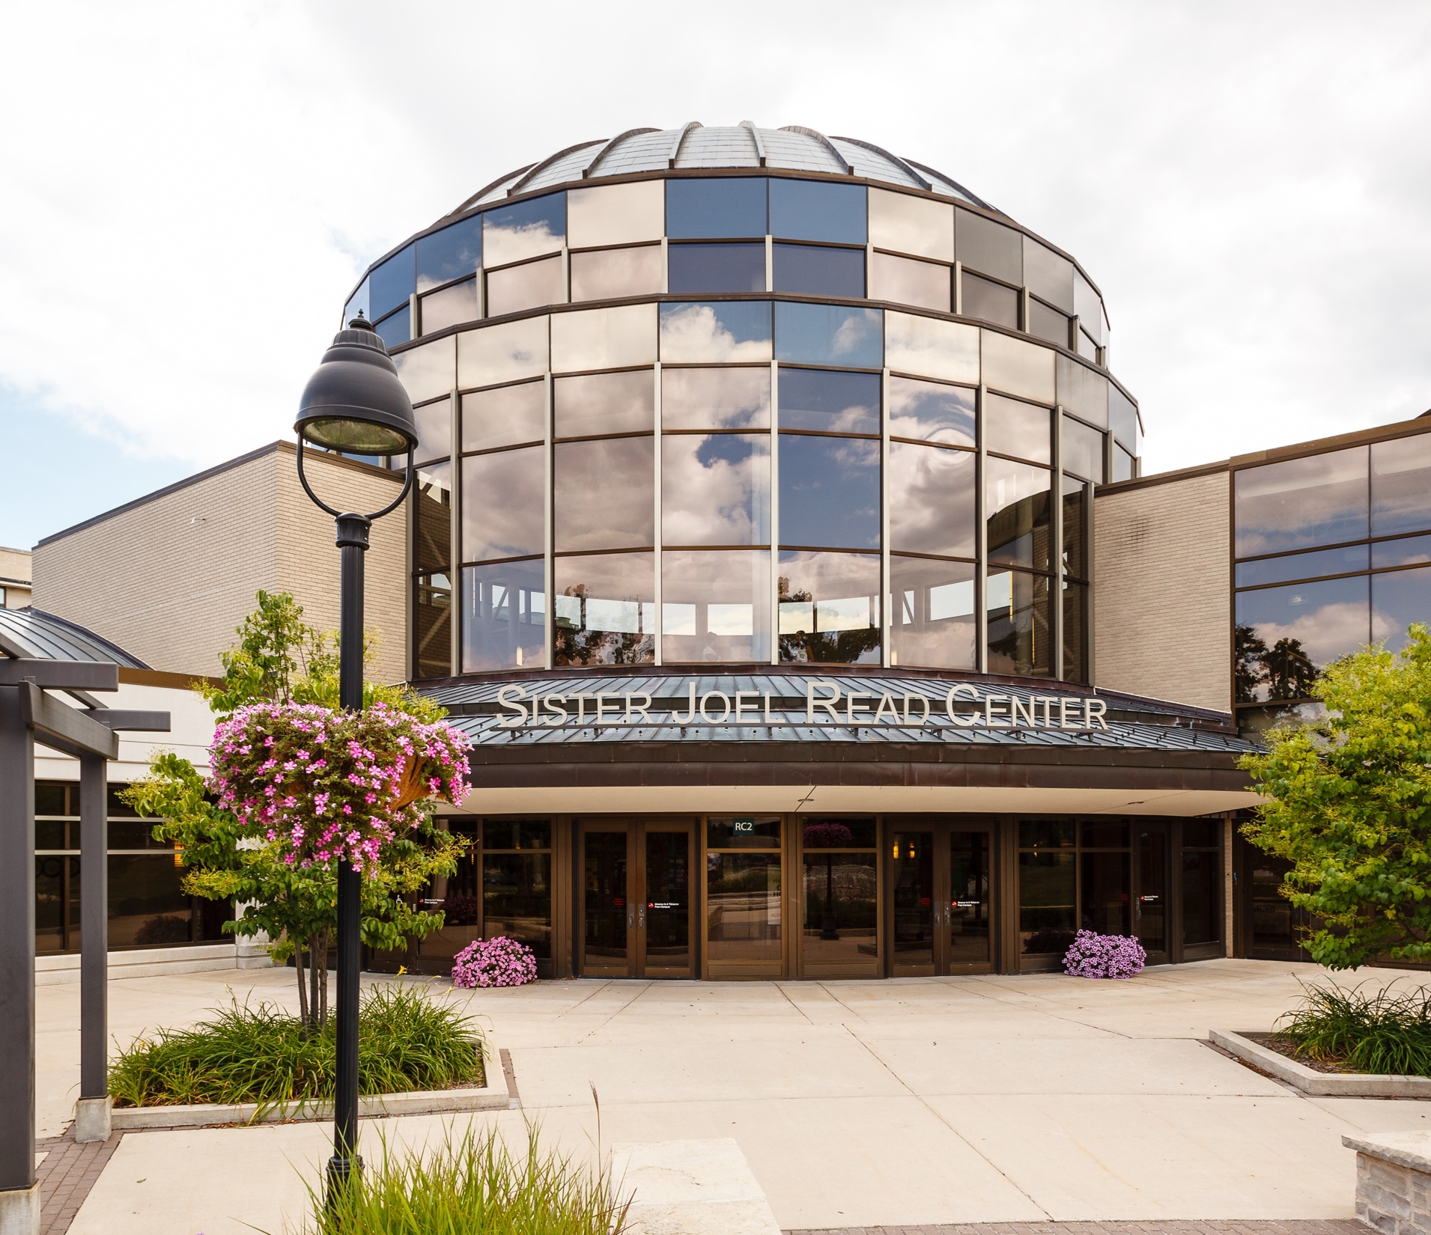
January Institute: Day 2
January 19, 2022

Slide 5
Visioning the Future
“You can’t be what you can’t see.”
–Captain Sally Ride

Slide 6
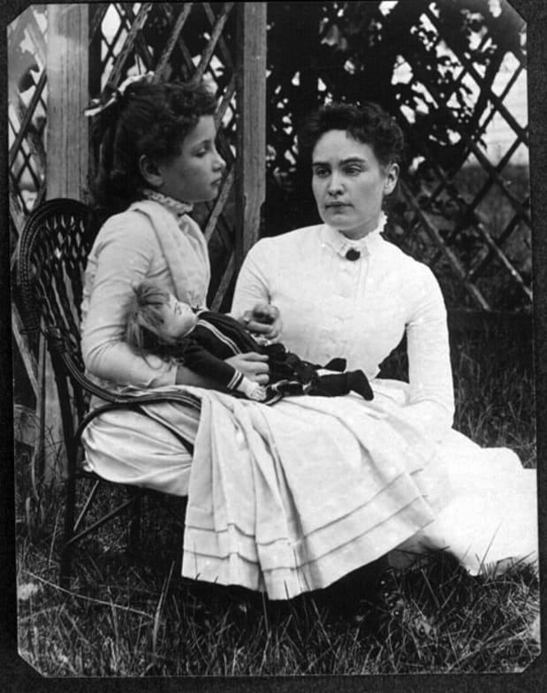
Bold Impulse to Soar
“One can never consent to creep when one feels an impulse to soar.”
–Helen Keller

Slide 7
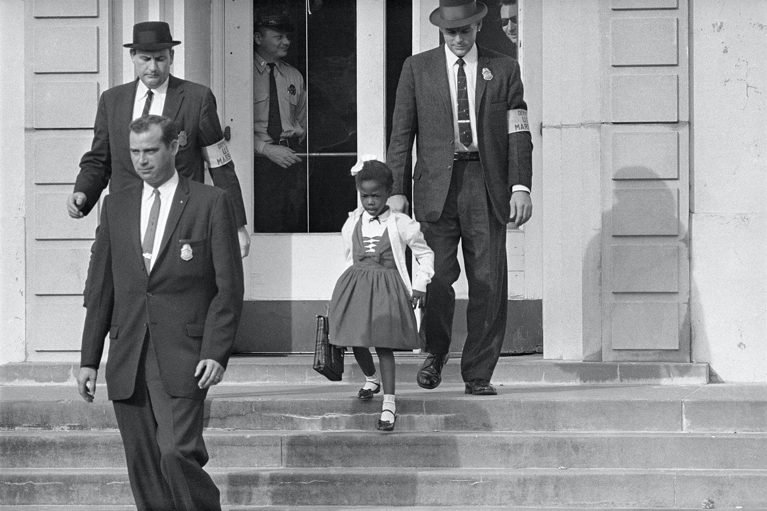
It Takes a Community
“That fateful walk to school began a journey, and we all must work together to continue moving.”
-Ruby Bridges

Slide 8
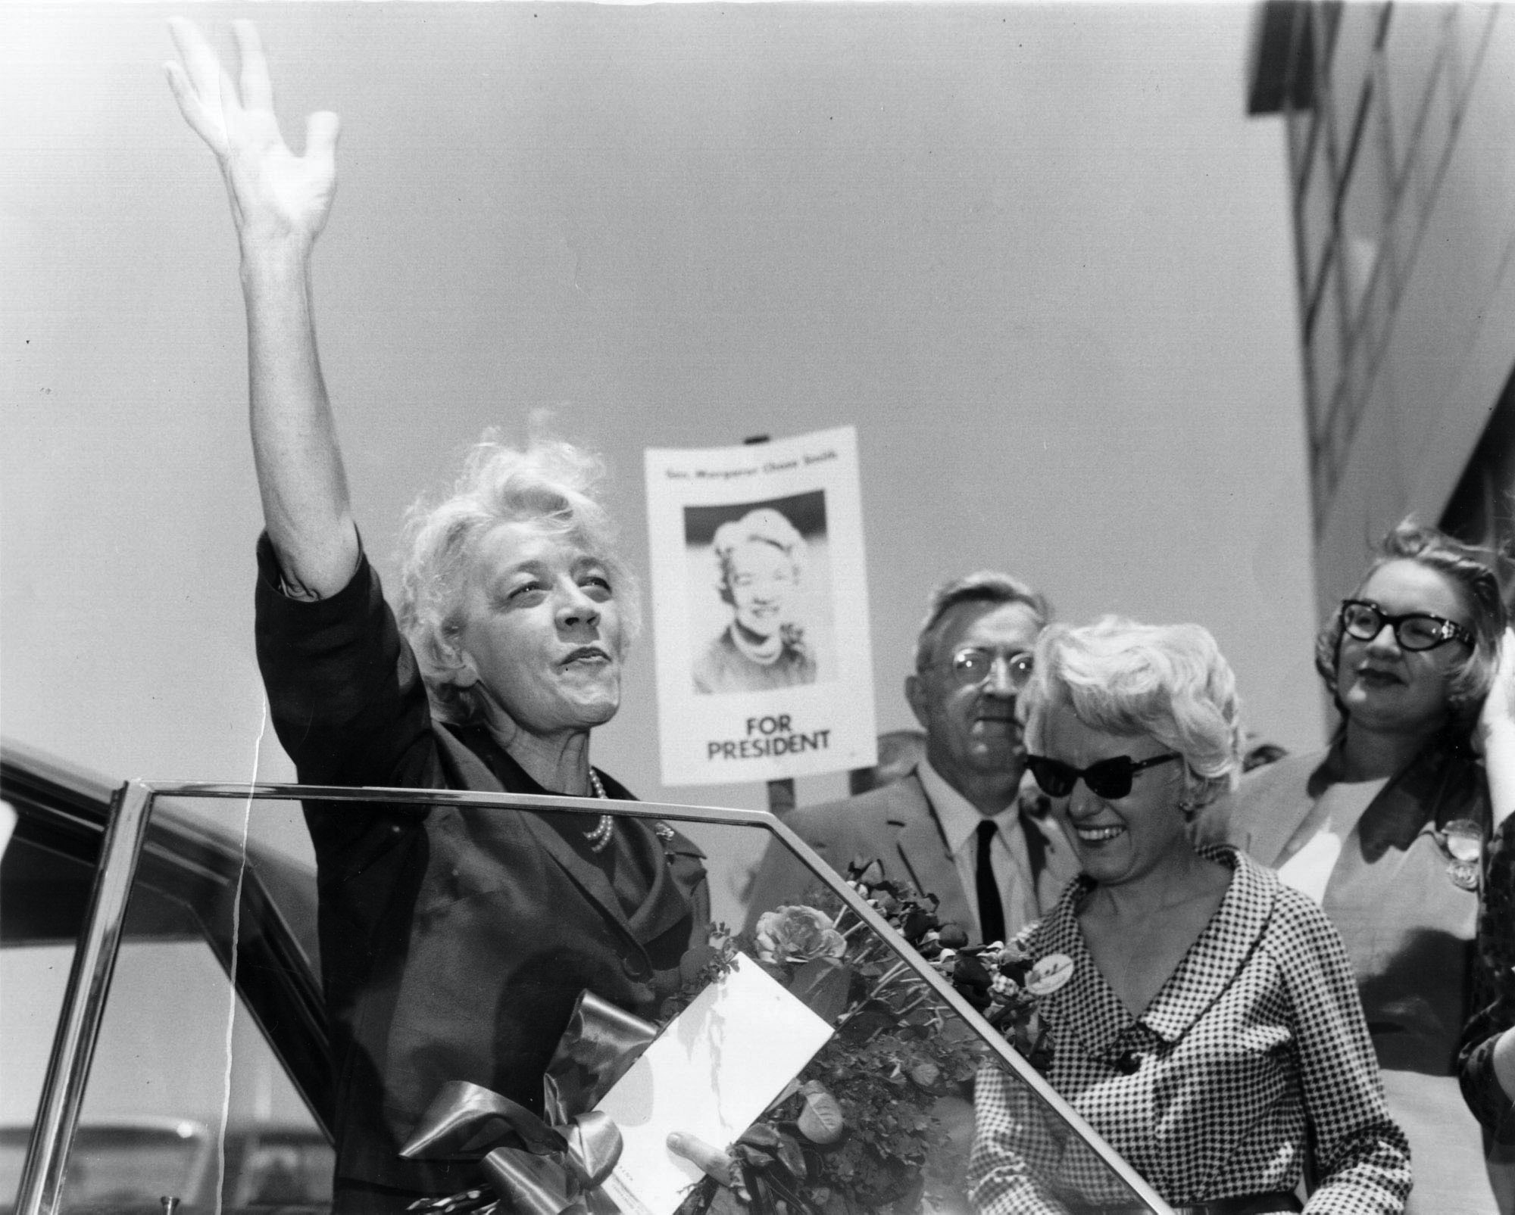
Care and Moral Courage
“The right way is not always the popular and easy way. Standing for right when it is unpopular is a true test of moral character.”
–Senator Margaret Chase Smith

Slide 9
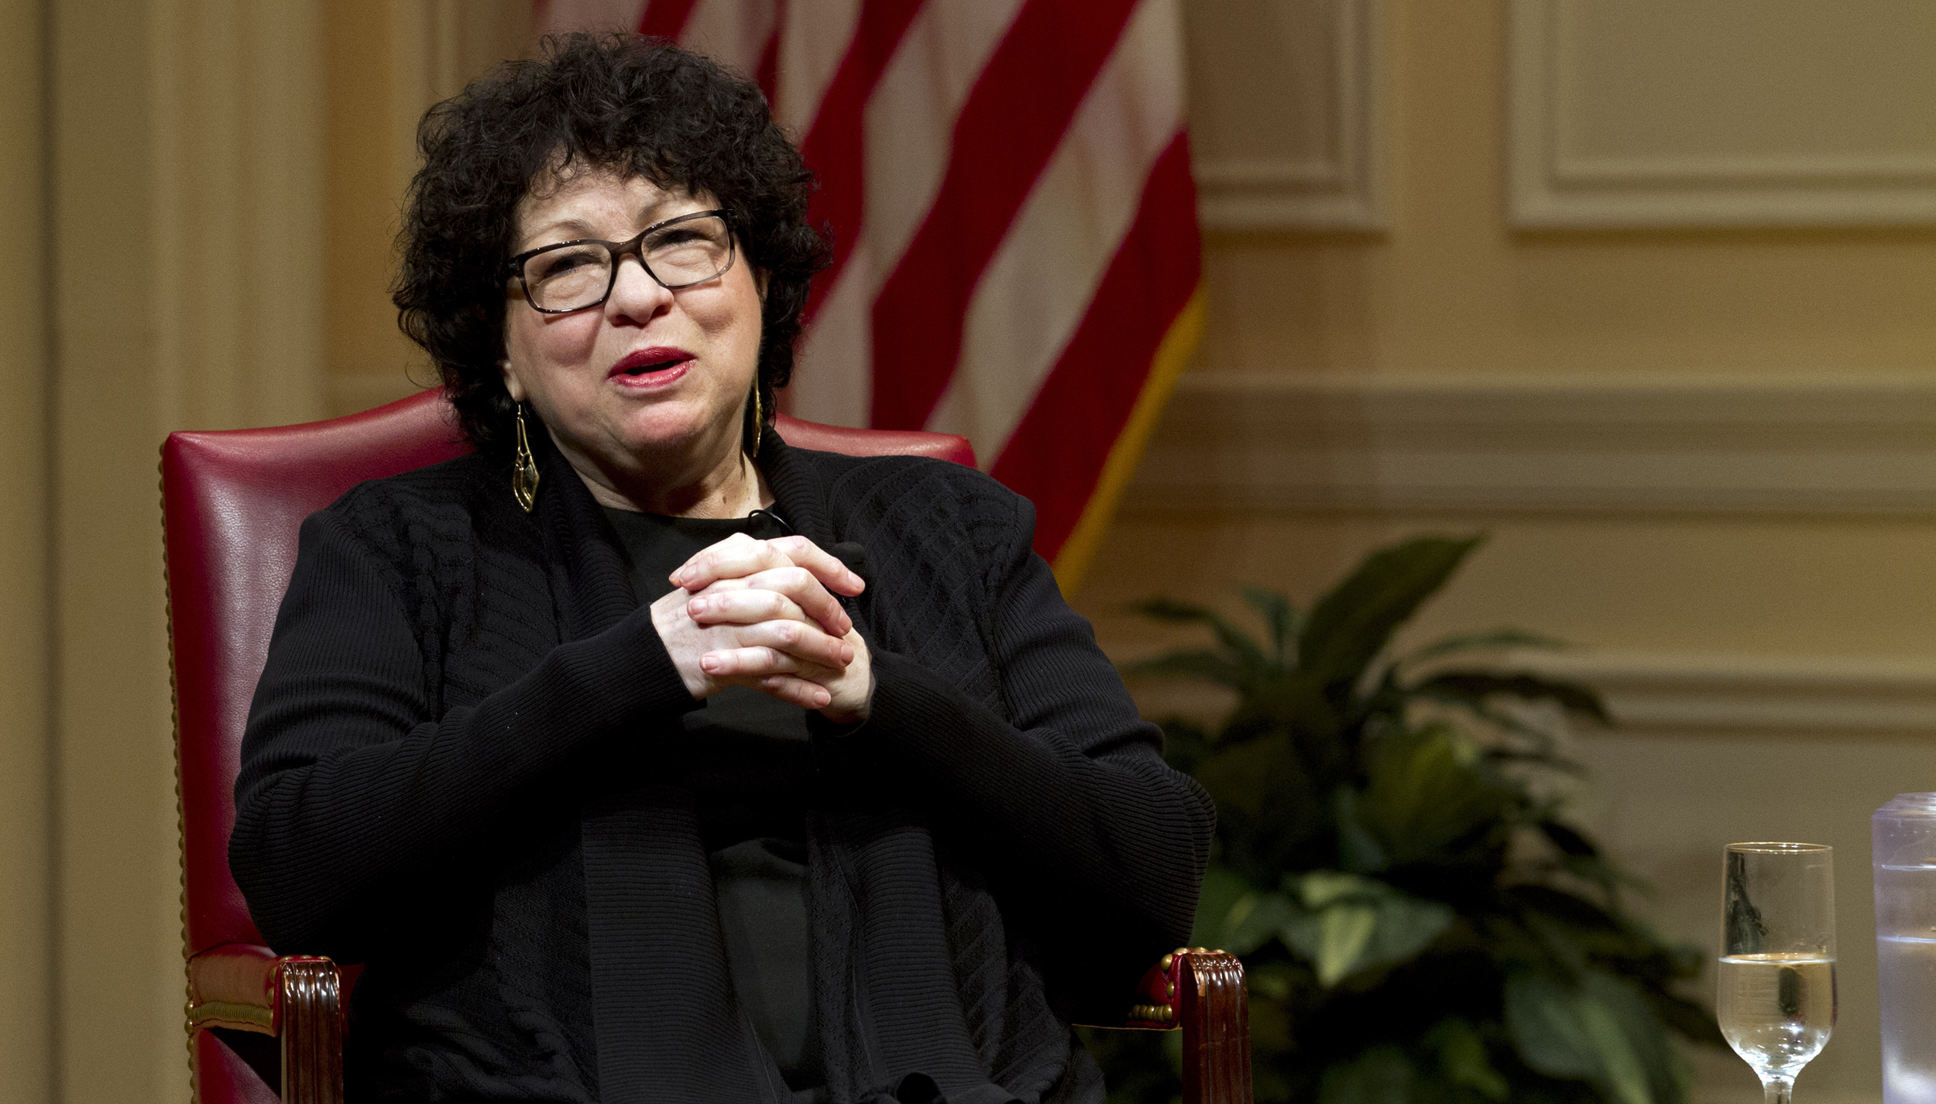
Optimism and Stubborn Perseverance
“I have never had to face anything that could overwhelm the native optimism and stubborn perseverance I was blessed with.” –Justice Sonia Sotomayor

Slide 10
Strategic Plan Context
Jill Desmond, Ed.D. Chief of Staff

Slide 11
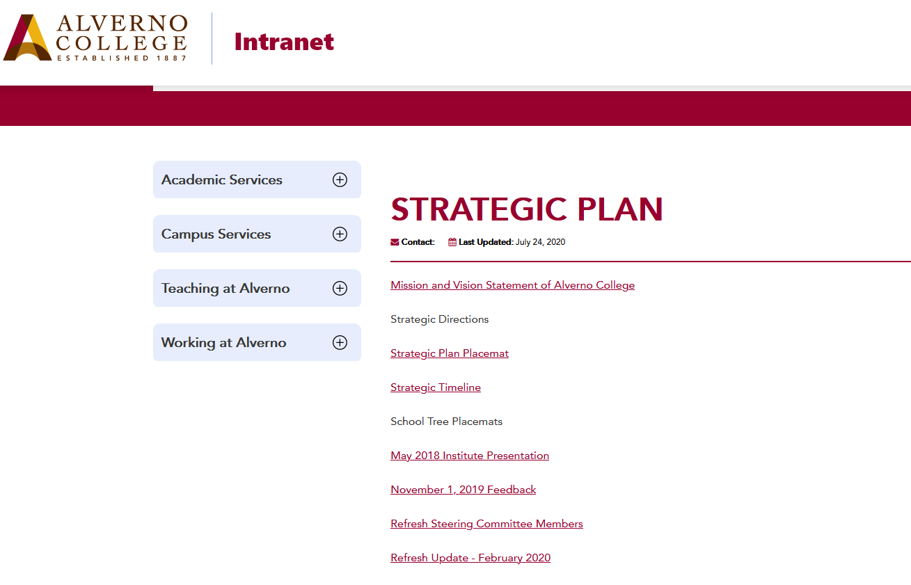
Alverno’s Strategic Plan
Overview
Strategic Plan – brief overview, directions and priorities
Strategic Refresh
Strategic Plan today
Looking for more information about the Strategic Plan?

Slide 12
Strategic Directions
Enhance internal and external understandings of Alverno as a Catholic, Franciscan college that:
focuses primarily on the undergraduate education of women;
intentionally serves a diverse student population; and
seeks to enroll students of high ability with access to a limited range of higher education options
Strengthen the women’s weekday undergraduate college by building diverse programs and revenue streams around it.

Slide 13
Strategic Plan Refresh Timeline
Summer & Fall 2020
Key projects move forward
Alverno Accelerate
New Pivot pathways
Urban Educator Supplemental Licensure Program
Data Science
Public Health
Nov/ Dec 2019
Refresh kick-off
Steering Committee formed
Review of Strategic Plan
February 2020
Work teams formed
Work team research and work begins
January 2020
Analysis of internal enrollment trends and external demographic trends
Articulation of priorities
March 2020
Majority of work paused to prioritize move to remote learning
Fall 2020
Refreshing the Refresh

Slide 14
Strategic Plan
Areas of Focus
Academic Programs
New
Expanded
Refreshed
Student Success
Retention
Systems & Processes

Slide 15
Enrollment Context and Enablers
Kate Lundeen
Vice President for Enrollment & Student Success

Slide 16
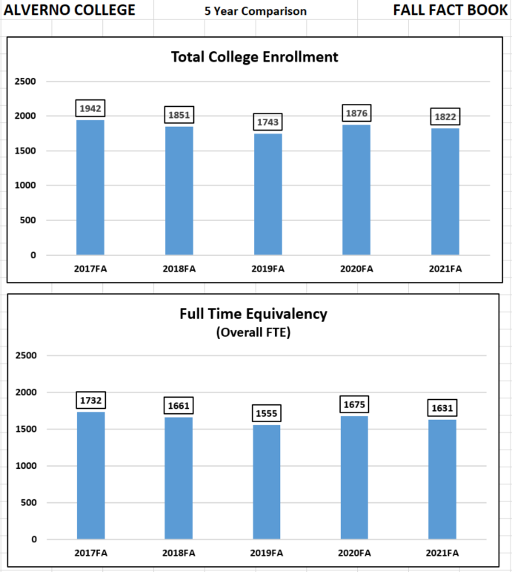
Enrollment
Fall 2021 Headcount Women’s Weekday College - 719 Adult Undergraduates - 198 Graduate - 905
Women’s Weekday College - 719
SALNI - 588
Graduate (non-SALNI) - 515

Slide 17
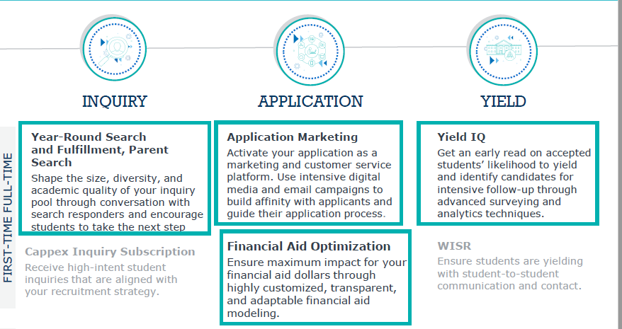
Enrollment 360 - Recruitment support from EAB
Notes:
Our fall of 2021 class is “not looking the way that we wanted it to” and we would like to be able to improve.
Entering class 2022 is the priority. How do we ensure that we produce a strong class and grow our undergraduate enrollment?
And while we know 2022 is the priority, the balance between 2022 and 2023 is “crucial”. Without help on the sophomore/junior side, we are always catching up in senior year.
Our team is talented lean and mean but an experienced, proven partner bringing scale would be helpful.
We need help with yield and financial aid , as well, and we would like to take look at including this in our proposal.
We have turnover happening right now on the staffing side and would love a partner to be able to pick up and help guide us through the transition.
Everyone else has a “whole team behind them”. To properly compete and to attract the best students, we also need a full team behind us.
Do we need to fight after the same students we have been going after or do we need to try to attract new students? Our audience selection process is going to be key.
We know our application needs some work. How can we make the experience that our students have “frictionless”?
While we know that our budget is tight, we also realize that improvement
and scale is going to require an investment.

Slide 18
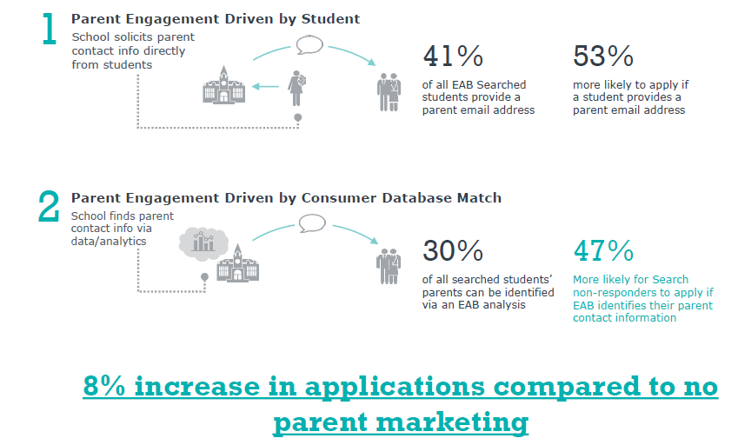
Enrollment 360 - Year Round Search and Fulfillment and Parent Search

Slide 19
Enrollment 360 - Application Marketing

Slide 20
Enrollment 360 - Financial Aid Optimization

Slide 21
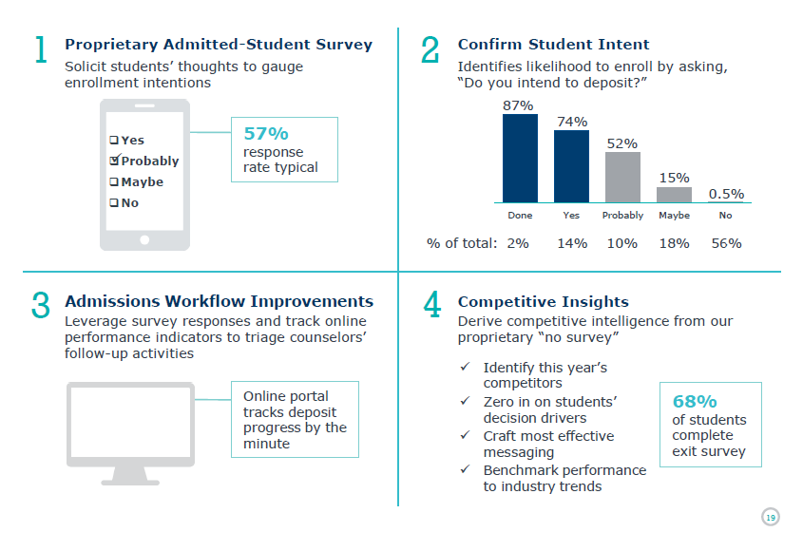
Enrollment 360 - Yield IQ

Slide 22
Enrollment Priorities
New First Year - Enrollment 360 w/ EAB (new investment)
New Transfers - RaiseMe/Transferology (redirected)
Continuing WWDC (Retention) - Blaze + Spark (enhanced)
SALNI Undergraduates - Encoura/Niche (redirected)
Graduate Students - Encoura/Niche (redirected)

Slide 23
Academic Financial Sustainability
Joseph Foy, Ph.D.
Vice President for Academic Affairs

Slide 24
Four Areas of Opportunity
Academic Efficiency
Examining organization of academic departments and programs
Evaluating administrative and faculty capacity
Reducing small and underfilled sections; putting courses on rotation
New Program Launch
Identify next horizon program opportunities and breakeven points
Student Retention/Success
Identify barriers to retention and strategies to remove those barriers
Portfolio Assessment and
Prioritization
Understand performance of each program against value drivers
Identify financial implications associated with reorganizing portfolio of offerings

Slide 25
Process
New Program Launch
Resources provided to Academic Deans
New Programs Identified in Metrics and Strategy for 2,400 by 2024 Vision
Student Retention/Success
Vision/Mission/Outcomes clearly defined on website:
Improve one-year undergraduate retention rate from 72% to 75% with an aspiration of 82%
Six-year graduation rates increase from 42% to 60% by 2026
Retention rates increase from 72% to 82% by 2026
Improve the retention rates of our most academically at-risk (Alverno Success)
Fall 2021 Progress

Slide 26
Process
Focus on Academic Efficiency and Program Portfolio Eval/Priority
Gathered data and resources in both of these areas to provide a common set of workbooks to help inform conversation and planning
Marlene Neises = project manager for data collection process
Data was reviewed by Deans and Academic Program Directors and shared with Enrollment, Marketing and Career Leaders for validity; open process
Timeline for Data Collection:
Academic Efficiency – August-September
Portfolio Assessment and Prioritization – September-October
Student Retention – October-November
New Program Launch – November-December

Slide 27
Process
Now that is data collected, we will be handing off the data today along with the ask for work in two areas:
Academic Efficiency
Academic Program Portfolio Assessment and Prioritization
First round of implementation to conclude spring/summer 2022
Ongoing process of continuous improvement

Slide 28
Goals
Identify areas of opportunity for reducing expenses while delivering high-quality student experience
Identify areas of growth potential given enrollment shifts
Align resources to meet strategic priorities
Establish financially sustainable model of program delivery within the context of enrollment realities

Slide 29
Digital Transformation
Options, Decisions and Plans
Andrea Lee, IHM
President

Slide 30
A key and urgent strategic priority
Multiple Perspectives – Academic and Administrative
Discrete, as well as
overlapping & intersecting needs
Important area for investment
but resources not unlimited
2 Options considered and important decisions made
Notes:
Replace Colleague with another ERP.
Add best-of-breed solution to existing ERP to help us achieve our goals.
Most area use of Colleague is not meeting an important portion of their daily work and are using excel sheets to compensate.
Alternatively,, Improve internal service by utilizing what we have and add features as needed to improve utilization and modernize our processes. This will mean that we need to have deeper skills to accomplish this goal.
Now we are two different paths.

Slide 31
Our Strategic Plan Umbrella – 24 Targets
Technology and Systems
Technology takes center stage in planning for Alverno’s future
Systems & operations focused on enrollment improved
Systems & operations focused on academic programs improved
Systems & operations focused on business & admin functions improved

Slide 32
Tier 1&2 Metrics – Where we’re headed
TIER 1
Digital transformation achieved by 2025; i.e., a reliable and robust infrastructure; cybersecurity maturity; improved efficiency of business and academic processes; and a “data-driven” culture.
Level 4 & 5 cybersecurity maturity attained
Resources aligned with academic technology needs and general systems improvement.
TIER 2 (3.3. Technology )
Shorter Term goals connected to Tier 1 Destination Metrics

Slide 33
Followed Advice to Make the “Big Decision” First
OR
Managed IT Services
Manage Internally
Faster path to solutions
Slower, more incremental path to solutions
Access to skill sets we do not have and cannot afford
Gaps, particularly around cybersecurity, remain
Will cost more - about +17.5% over total current costs in the first year, then decreasing
Also higher costs annually but more gradual

Slide 34
After consultation with experts and trustees, we considered both options and chose…
Managed IT Services

Slide 35
Why Managed Services?
Immediate & more robust results and services for both academic & administrative computing
Major plus for cybersecurity support we cannot otherwise afford
Greater assurance of business continuity across the College
No disruption in the event of staff losses or other IT challenges

Slide 36
Assuming Managed Services
We considered three provider options, two of which were possible:
Dynamic Campus
Ellucian
Ferrilli (considered, but they don’t offer all needed services)

Slide 37
What was the decision path toward
Managed Services and Ellucian?
Clarified immediate & future academic & administrative needs with senior team
Understood integration alignment of needs in Enrollment, Student Success, Finance, HR and Academic areas with Managed Services capability
Refined RFP to external providers accordingly
Careful review of references and user experience with Presidents, CIOs and CFOs at current clients of each provider candidate
Careful review of proposed contract with finance, legal and trustee advisors before signing it on December 29, 2021

Slide 38
WHY Ellucian?
Largest player in the industry with many resources
Singular focus on higher education
2500 user colleges and universities world-wide – from very large to very small institutions
About 150+ colleges with Ellucian managed services contracts
Owner and the experts in the Colleague system we use

Slide 39
What Will Managed Services Mean?
…For Alverno College Services
Quicker, more refined access to reports needed for decision-making
Dramatic improvement in cybersecurity readiness and support
Assured backup when we need it
Better integration across departments in strategic plan implementation
Improved use of Colleague, ready assistance by its owner and supplier to 2500+ colleges and universities
Uninterrupted or improved services as we experience them now

Slide 40
What Will Managed Services Mean?
…For our Alverno Colleagues
Ellucian will become our IT staff employer on or about February 28.
The Managed Services contract does not include Ellucian becoming employer of our Media Hub, CIO, instructional technologists, student workers or on call Information Center staff. All remain as they are now.
During February, Ellucian will assess Alverno IT employee skills and career aspirations and align them with Ellucian and Alverno needs. Staff will be invited to apply for specific, available positions.
Alverno IT employees becoming permanent Ellucian staff may have opportunities here or elsewhere, including potential career enhancing opportunities.
Alverno IT employees not selected to joining receive severance and career counseling
Alverno will manage this transition with respect, dignity and gratitude.

Slide 41
What Will Managed Services Mean?
…For the College budget
Approximately 17.5% increase over total current IT cost in the first year, then decreasing
Includes cost of modernization project already underway
Ellucian offers substantial Grant Development assistance
Further efficiencies probable as many external provider assistance needs now outsourced will be brought under the Ellucian umbrella
Optimizing use of Colleague will benefit Alverno in many ways, including “more impact for the dollars spent” and easy access to other external resources

Slide 43
Nevertheless, Alverno Persists
“So, if anyone ever tells you no,
if anyone every says your voice isn’t important
or your dreams are too big,
remember these women.
They persisted and so should you.”
-Clinton, She Persisted

Slide 44
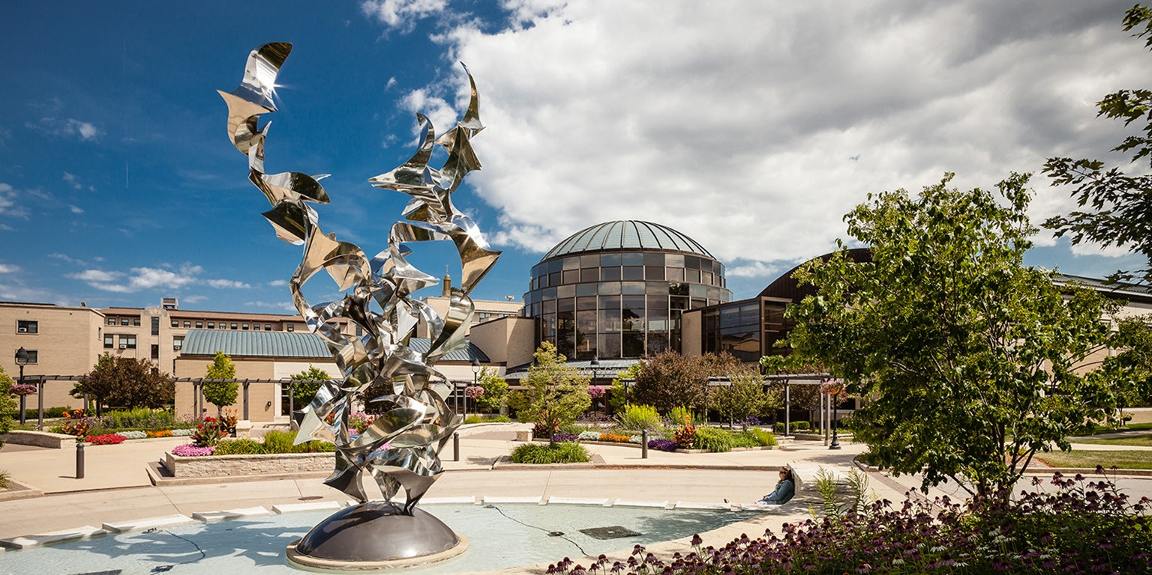
Thank you!
Q&A

